Slide 1
Functions
8.F.A.1 and 8.F.A.2

Slide 2
Standard
8.F.A.1 Understand that a function is a rule that assigns to each input exactly one output. The graph of a function is the set of ordered pairs consisting of an input and the corresponding output.

Slide 3
8.F.A.2 Compare properties of two functions each represented in a different way (algebraically, graphically, numerically in tables, or by verbal descriptions). For example, given a linear function represented by a table of values and a linear function represented by an algebraic expression, determine which function has the greater rate of change.

Slide 4
y = kx
k is the ______________
or the _________________
Constant of proportionality
Unit rate

Slide 5
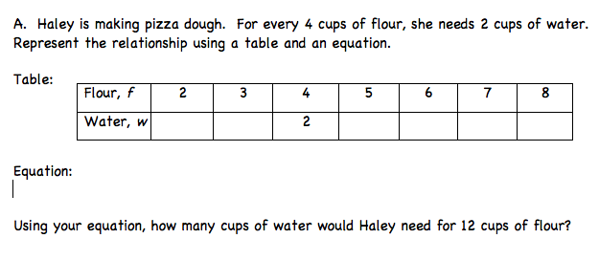
1. Prerequisite:
1
1.5
2.5
3
3.5
4
f = 2w
w = 0.5f

Slide 6
Cost (c)
1.50
1
3
2
4.50
3
6
4
7.50
5
9
6
10.50
7
Drinks(d)
c = 1.50d

Slide 7
800 40
1200 60
480 24
240
12
20
1
d = 20t

Slide 9
Functions
Introduction to Functions

Slide 10
Standard
8.F.A.1 Understand that a function is a rule that assigns to each input exactly one output. The graph of a function is the set of ordered pairs consisting of an input and the corresponding output.

Slide 11
2. Introduction to Functions
rule
produces
output
input
number
number
results
function

Slide 12
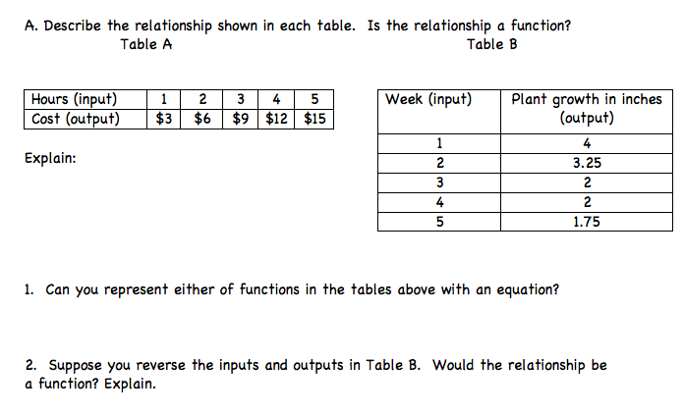
c = 3h

Slide 13
Is there one output for each input?
It is a function because the inputs do not repeat.

Slide 14
Is there one output for each input?
It is not a function because the inputs repeat.

Slide 15
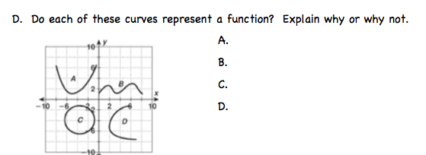
Function – one output to each input
Function – one output to each input
Not Function – one input to two outputs
Not Function – one input to two outputs

Slide 16
√ X

Slide 18
Functions
Comparing Functions

Slide 19
8.F.A.2 Compare properties of two functions each represented in a different way (algebraically, graphically, numerically in tables, or by verbal descriptions). For example, given a linear function represented by a table of values and a linear function represented by an algebraic expression, determine which function has the greater rate of change.

Slide 20
3. Comparing Functions

Slide 21
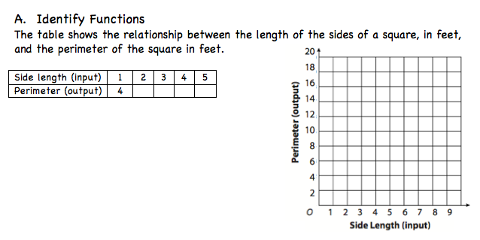
.
.
.
8
12
16
20
.
.
As the input increases by 1 the output increases by 4
y = 4x
No, because there can only be one output per input.

Slide 22
function
one output
input

Slide 23
rate
increases
decreases
Vertical change (rise)
Horizontal change (run)

Slide 24
x₁, y₁
x₂, y₂
x₁, y₁
x₂, y₂
7 – 5 2
5 – 4 1
16 – 8 8 2
9 – 5 4 1

Slide 25
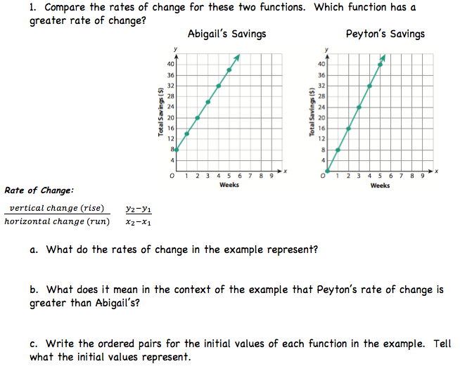
(4, 32)
(3, 24)
(2, 20)
(2, 16)
(0, 8)
(1, 8)
20 – 8 12 6
2 – 0 2 1
16 – 8 8
2 – 1 1
Abigail saves $6 per week
Peyton saves $8 per week
Peyton saves $2 more a week than Abigail
Abigail (0, 8) – had $8 when she began saving
Peyton (0, 0) – had $0 when she began saving

Slide 26
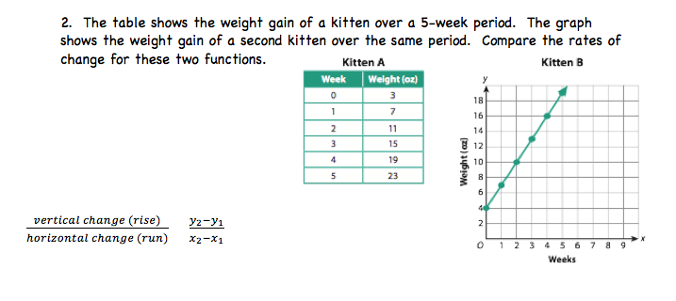
x
y
(4, 16)
(3, 13)
(2, 10)
(1, 7)
7 – 3 4
1 – 0 1
(0, 4)
16 – 13 3
4 – 3 1

Slide 27
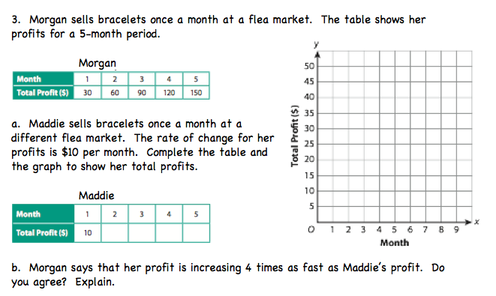
.
.
(5, 50)
x
y
.
(4, 40)
.
(3, 30)
.
(2, 20)
(1, 10)
x
y
20
30
40
50

Slide 28
8.F.A.2 Compare properties of two functions each represented in a different way (algebraically, graphically, numerically in tables, or by verbal descriptions). For example, given a linear function represented by a table of values and a linear function represented by an algebraic expression, determine which function has the greater rate of change.

Slide 29
((
(
(
(
(
9 – 3 6 2
3 – 0 3 1
13 – 9 4 2
5 – 3 2 1

Slide 30
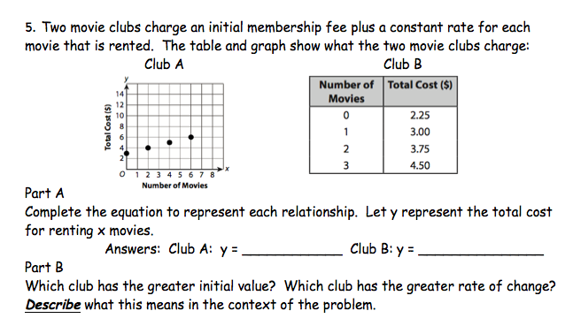

Slide 31
Find the rate of change: (3, 7) (6, 19)

Slide 32
Find the rate of change: (5, 4) (6, 9)

Slide 33
Standard
8.F.A.1 Understand that a function is a rule that assigns to each input exactly one output. The graph of a function is the set of ordered pairs consisting of an input and the corresponding output.

Slide 34
8.F.A.2 Compare properties of two functions each represented in a different way (algebraically, graphically, numerically in tables, or by verbal descriptions). For example, given a linear function represented by a table of values and a linear function represented by an algebraic expression, determine which function has the greater rate of change.

