Slide 1
Rational and Irrational Numbers

Slide 2
Standard
8.NS.A.1 Know that numbers that are not rational are called irrational. Understand informally that every number has a decimal expansion; for rational numbers show that the decimal expansion repeats eventually, and convert a decimal expansion, which repeats eventually into a rational number.

Slide 3
Rational Number –
Any number that can be expressed as a ratio (fraction) of two integers
Repeating Decimals
Terminating Decimals

Slide 4
Irrational Numbers
Any number that cannot be expressed as a ratio (fraction) of two integers
Any number that is not a repeating or terminating decimal

Slide 5
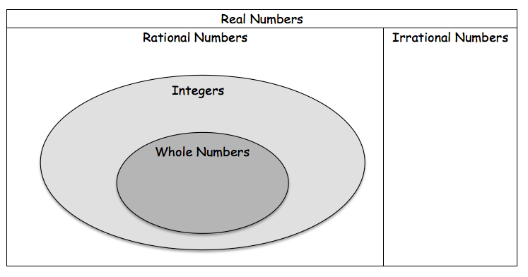

Slide 6
Reflect
1) Consider the decimal 0.202002000200002000002... Do you think this decimal represents a rational number? Why or why not?

Slide 7
2) Do you think a negative sign affects whether or not a number is a rational number? Use - 4/5 as an example. Why or why not?

Slide 8
3) Do you think a mixed number is a rational number? Explain.

Slide 9
Standard
8.NS.A.1 Know that numbers that are not rational are called irrational. Understand informally that every number has a decimal expansion; for rational numbers show that the decimal expansion repeats eventually, and convert a decimal expansion, which repeats eventually into a rational number.

Slide 10
Long Division Time

Slide 12
Question…Do you think that decimals that have repeating patterns always have the same number of digits in their pattern? Explain.

Slide 13
Writing Mixed Numbers as Decimals

Slide 14
Practice:

Slide 16
Fractions as Decimals

Slide 17
Decimals to Fractions

Slide 18
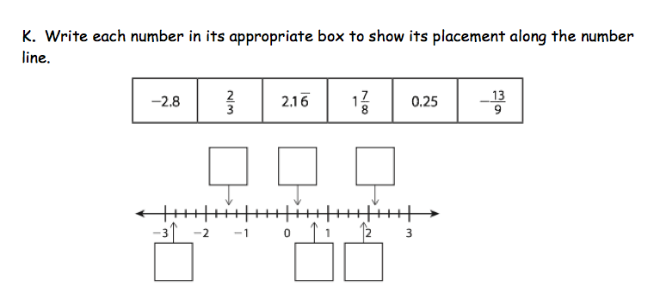
Comparing and Ordering Real Numbers

Slide 19
Standard
8.NS.A.1 Know that numbers that are not rational are called irrational. Understand informally that every number has a decimal expansion; for rational numbers show that the decimal expansion repeats eventually, and convert a decimal expansion, which repeats eventually into a rational number.

Slide 20
Repeating Decimals as Fractions

Slide 23
What pattern do you see?

Slide 24
Do you think it will work with all repeating decimals?

Slide 25
What is the fraction for:
a. 0.1111111111

Slide 26
b. 0. 135135135135

Slide 27
c. 0.3636363637

Slide 28
d. 0.666666667

