Slide 1
Simplifying Integer Exponents

Slide 2
Standard
8.EE.A.1. Know and apply the properties of integer exponents to generate equivalent numerical expressions. For example, 3² × 3⁻⁵ = 3⁻³= 1/3³ = 1/27.

Slide 3
Integer Exponent Poem
Zero exponents are lonely… The answer is ONE only Negative exponents have a hitch… Positions in a FRACTION SWITCH Multiplying powers not so bad… Exponents ADD Power to power must simplify…. Exponents MULTIPLY Dividing powers require a little action… Exponents need SUBTRACTION

Slide 4
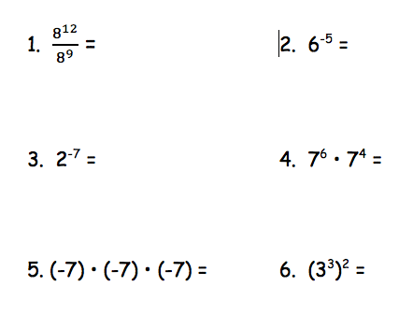

Slide 5
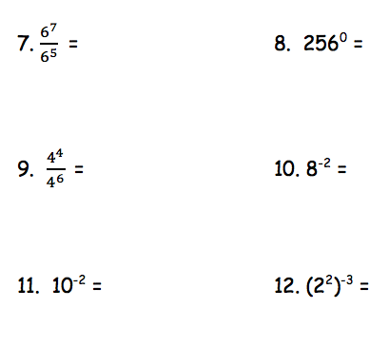

Slide 6
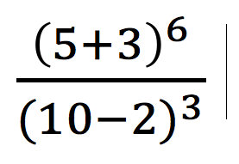
Simplify the expression

Slide 7
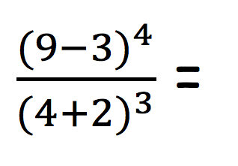
Simplify the expression

Slide 8
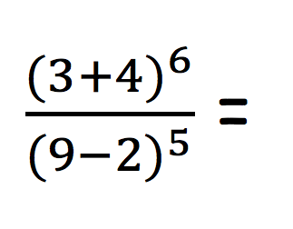
Simplify the expression

Slide 9
Simplify the expression

Slide 10
Simplify the expression

Slide 11
Simplify the expression

Slide 12
Simplify the expression

Slide 13
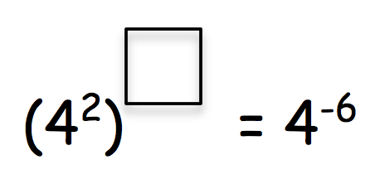
Find the missing Exponent

Slide 14
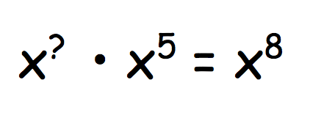
Find the missing Exponent

Slide 15
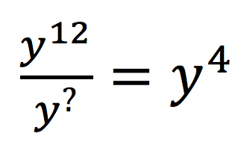
Find the missing Exponent

Slide 16
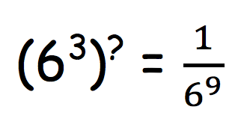
Find the missing Exponent

