Slide 1
Solving System of equations

Slide 2
Standard
8.EE.C.8.a Understand that solutions to a system of two linear equations in two variables correspond to points of intersection of their graphs, because points of intersection satisfy both equations simultaneously.

Slide 3
Graphing
1. Write equations in ______________________.
2. Graph both equations.
3. _______________is where the two lines intersect.
slope intercept form
y = mx + b
Solution

Slide 4
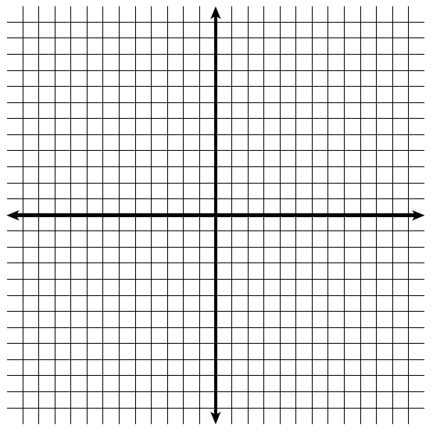
.
y = x + 3
y = 2x + 5
.
.
.
.
.
.
.
.
.
.

Slide 5
y = 4x – 11
y = -3x + 3

Slide 6
Remember:
Make sure equations are in y-intercept (slope intercept)
y = -x + 4
2y + 2x = 8

Slide 7
Remember:
Make sure equations are in y-intercept (slope intercept)
y = ½x + 2
2y = x - 6

Slide 8
Multi Step Equation Review
1. -18 – 6m = 6(1 + 3m)

Slide 9
Multi Step Equation Review
2. 2.3n + 4.98 = 3n + 2.6

Slide 10
Multi Step Equation Review
3. -6.1p – 27.7 + 10.9p = 2.8p – 0.3

Slide 11
Multi Step Equation Review
4. 6(6y + 6) – 5 = 1 + 6y

Slide 12
Multi Step Equation Review
10(v + 3) + 9v + 4 = 3 + v – 5

Slide 13
Multi Step Equation Review
6. -16 + 5n = -7(-6 + 9n) + 3

Slide 14
Multi Step Equation Review
-4x + 2(5x – 6) = -3x – 39

Slide 15
Multi Step Equation Review
8. -10y + 3(8 + 8y) = -6(y – 4)

Slide 16
Transitive
1. For equations already in slope intercept form.
2. Set equations up equal to each other.
3. Solve for x.
4. Plug the value of x into one of the original equations to solve for y.

Slide 17
y = x + 4
y = -x – 4
x + 4 = -x - 4
If x = _____ then y = _____
Solution: _____________

Slide 18
y = -3x + 2
y = -x - 8
-3x + 2 = -x - 8
If x = _____ then y = _____
Solution: _____________

Slide 19
y = 2x + 9
y = -8 + 2x
2x + 9 = -8 + 2x
If x = _____ then y = _____
Solution: _____________

Slide 20
y = 3x + 5
y = 3x - 10
3x + 5 = 3x - 10
If x = _____ then y = _____
Solution: _____________

Slide 21
Substitution
1. Set up one equation in slope intercept form.
2. Substitute the expression from Step 1 into the other equation and solve for the other variable.
3. Substitute the value from step 2 into either original equation and solve for the second variable.

Slide 22
Example 1: -3x + y = 1
4x + y = 8
1st Rewrite in y-intercept form:
-3x + y = 1
2nd Substitute y = 3x + 1 into 4x + y = 8
3rd 4x + 3x + 1 = 8
If x = _____ then y = _____ Solution: _____________

Slide 23
Example 2: 3x + y = 8
6x + 2y = 16
1st Rewrite in y-intercept form:
3x + y = 8
2nd Substitute y = -3x + 8 into 6x + 2y = 16
3rd 6x + 2(-3x + 8) = 16
If x = _____ then y = _____ Solution: _____________

Slide 24
Example 3: 2x – 3y = -24 x + 6y = 18
1st Rewrite in x-intercept form:
x + 6y = 18
2nd Substitute x = -6y + 18 into 2x – 3y = -24
3rd 2(-6y + 18) – 3y = -24
If x = _____ then y = _____ Solution: _____________

Slide 25
Example 3: 2x – 3y = -24 x + 6y = 18
1st Rewrite in y-intercept form:
2x – 3y = -24
2nd Substitute y = x + 8 into x + 6y = 18
3rd x + 6( x + 8) = 18
If x = _____ then y = _____ Solution: _____________

Slide 26
Elimination
1. Add or subtract the equations to eliminate one variable.
2. Solve the resulting equation for the other variable.
3. Substitute the value into either original equation to find the value of the eliminated variable.

Slide 27
Example 4: 3x + y = 11
-2x + y = 1
1st Rewrite in y-intercept form:
-2x + y = 1
2nd Substitute y = 2x + 1 into 3x + y = 11
3rd 3x + 2x + 1 = 11
If x = _____ then y = _____ Solution: _____________

