Slide 1
Hip to Be Square
Square Root and Cube Root

Slide 2
Standard:
8.EE.A.2. Use square root and cube root symbols to represent solutions to equations of the form x² = p and x³ = p, where p is a positive rational number. Evaluate square roots of small perfect squares and cube roots of small perfect cubes. Know that √2 is irrational.

Slide 3
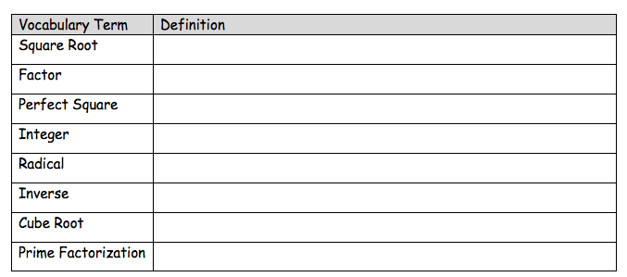
Vocabulary:

Slide 4
What do you know about squares:

Slide 6
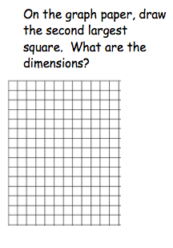
11 x 11

Slide 7
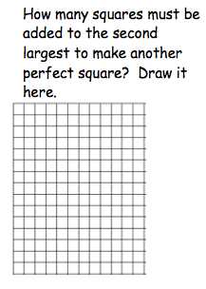
23

Slide 8
Using your Geo Board make the first 10 perfect squares. Then fill in the table with your findings.
1
1
1
4
2
2
9
3
3
16
4
4
25
5
5
36
6
6
49
7
7
64
8
8
81
9
9
100
10
10
196
14
14
225
15
15
121
11
11
144
12
12
169
13
13

Slide 9
What is the relationship between the side lengths and the area of the square?

Slide 10
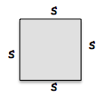
Explore It:
The length of each side of a square
measures s inches long. The area of
the square is 49 in². What is the
length of one side of the square?

Slide 11
Use the math you know to answer the following:
a. Describe in words how to find the area of the square given that each side is s inches long.
Multiply s times s

Slide 12
b. Write a multiplication expression using the variable s to represent the area of the square.
s • s

Slide 13
c. Write an expression using the variables s and an exponent to represent the area of the square:
s²

Slide 14
d. Write an equation setting your expression equal to the area of the square given in the problem:
s² = 49

Slide 15
e. Consider the factors of 49. Explain what the two sides of the equation have in common when you write each as the product of two factors:
Each can be written as the product of something times itself.
s² = s • s
49 = 7 • 7

Slide 16
Now, look at the equation you wrote on the previous page, s ² = 49. How do you solve an equation where a variable squared is equal to a perfect square?
You have solved equations before by using _______________ operations.
You solved addition equations by ________________.
You solved division equations by ________________.
inverse
subtracting
multiplying

Slide 17
So, what is the inverse operation of squaring a number?
Finding the square root

Slide 18
A square root of a number is any number that you can multiply by __________to get your original number.
For example: 3 is a _____________of 9, because 3 • 3 = 9. Another square root of 9 is -3, because (-3) • (-3) = 9.
itself
square root

Slide 19
The symbol means positive square root.
So, ______________________________

Slide 20
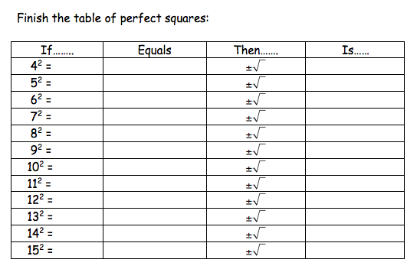
16 16 4, -4
25 25 5, -5
36 36 6, -6
49 49 7, -7
64 64 8, -8
81 81 9, -9
100 100 10, -10
121 121 11, -11
144 144 12, -12
169 169 13, -13
196 196 14, -14
225 225 15, -15

Slide 21
Reflect:
What is the difference between dividing 16 by 2 and finding the square roots of 16?
* Division is making equal groups from one group. A group of 16 can be organized into 2 groups with 8 in each group.
* Finding the square root is finding what number multiplied by itself. 4² = 16 and -4² = 16.

Slide 22
Standard:
8.EE.A.2. Use square root and cube root symbols to represent solutions to equations of the form x² = p and x³ = p, where p is a positive rational number. Evaluate square roots of small perfect squares and cube roots of small perfect cubes. Know that √2 is irrational.

Slide 23
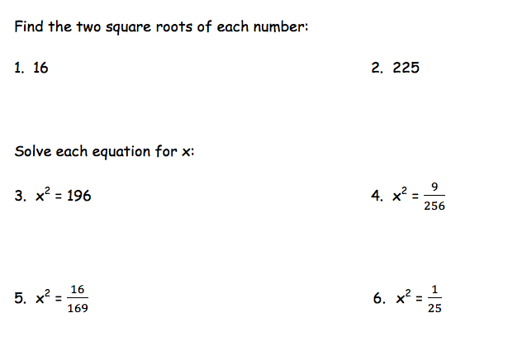

Slide 24
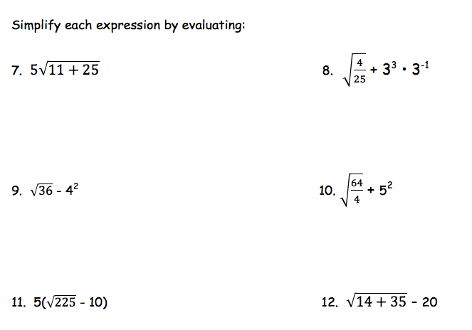

Slide 25
Cube Root
Square Root and Cube Root

Slide 26
Standard:
8.EE.A.2. Use square root and cube root symbols to represent solutions to equations of the form x² = p and x³ = p, where p is a positive rational number. Evaluate square roots of small perfect squares and cube roots of small perfect cubes. Know that √2 is irrational.

Slide 27
3
3
27
3
3

Slide 28
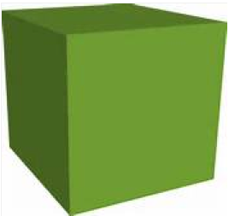
Solve it: each edge of a cube measure a feet long. The volume of the cube is 125 ft³. What is the measure of each edge of the cube?
1. Picture it (draw and label the cube):
a
a
a

Slide 29
2. You can apply the formula for the volume of a cube, which is ___________________.
a • a • a = V length = a, width = a, height = a
a³ = V
a³ = 125

Slide 30
5 25
5 5

Slide 31
4. Write 125 as the product of three factors. ________________________________.
5 • 5 • 5

Slide 32
5. Write 125 as a power of base 5. ________________________________________.
5³

Slide 33
6. What does 125 have in common with a³ when 125 is written as a power?___________.
Each is cubed

Slide 34
Perfect cube
inverse
three

Slide 35
125
5³
a 5
5

Slide 36
1
1
1
8
8
2
27
27
3
64
64
4
125
125
5

Slide 37
216
216
6
343
343
7
512
512
8
729
729
9
1000
1000
10

Slide 38
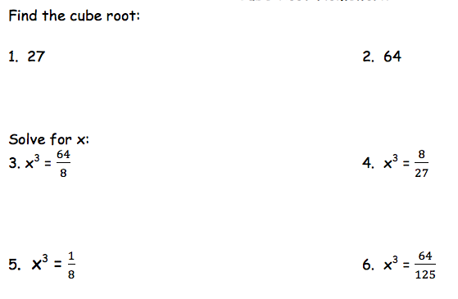

Slide 39
